Slide 1
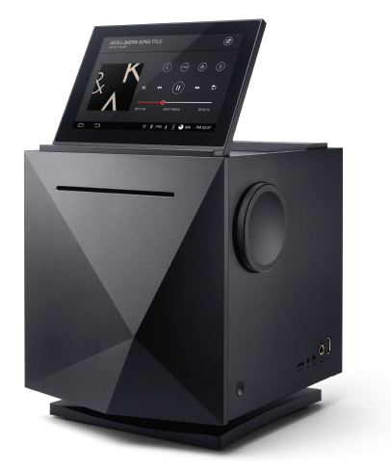
AK500N
THE ULTIMATE MQS
NETWORK AUDIO PLAYER

Slide 2
Elegant and lithe. Neutral and high resolution. Emotional and dynamic: the AK500N is one of the most complete network players and servers.
-- Evaluated by AUDIOPHILE magazine in Germany

Slide 3
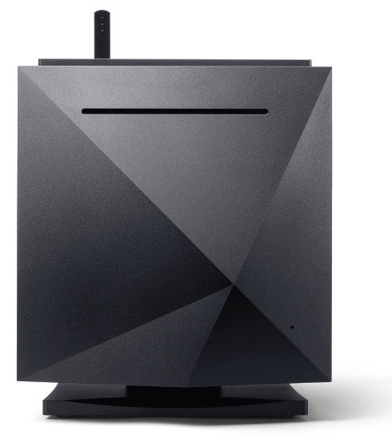
Astell&Kern desktop audio
Astell&Kern desktop audio gives you the freedom to select the sound you desire.
Portable Audio
Desktop Audio
CD-ripping
SSD storage
Better Sound
Extended I/O connections
PCM to DSD conversion

Slide 4
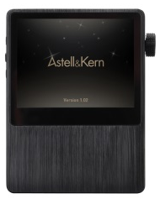
Product Line Up
Portable audio
Desktop audio

Slide 5
The first desktop audio from Astell&Kern
AK500N
One-click CD-ripping
Perfect noise isolation
PCM to DSD conversion
Excellent compatibility
Easy DLNA-based networking
High-reliability SSD

Slide 6
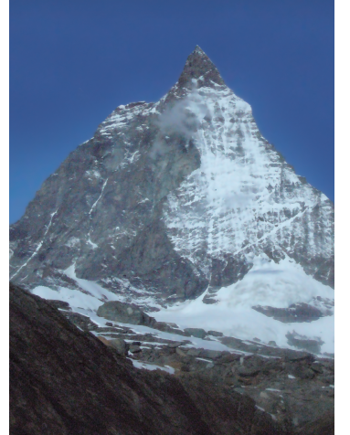
Design Concept
Greatness of Switzerland's Matterhorn
Ever-changing with time and the amount of light

Slide 7
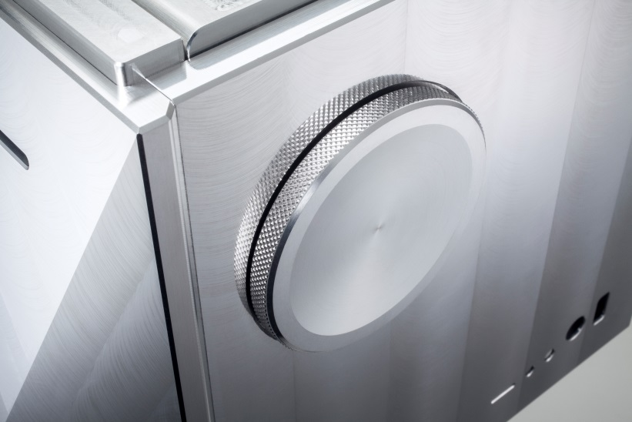
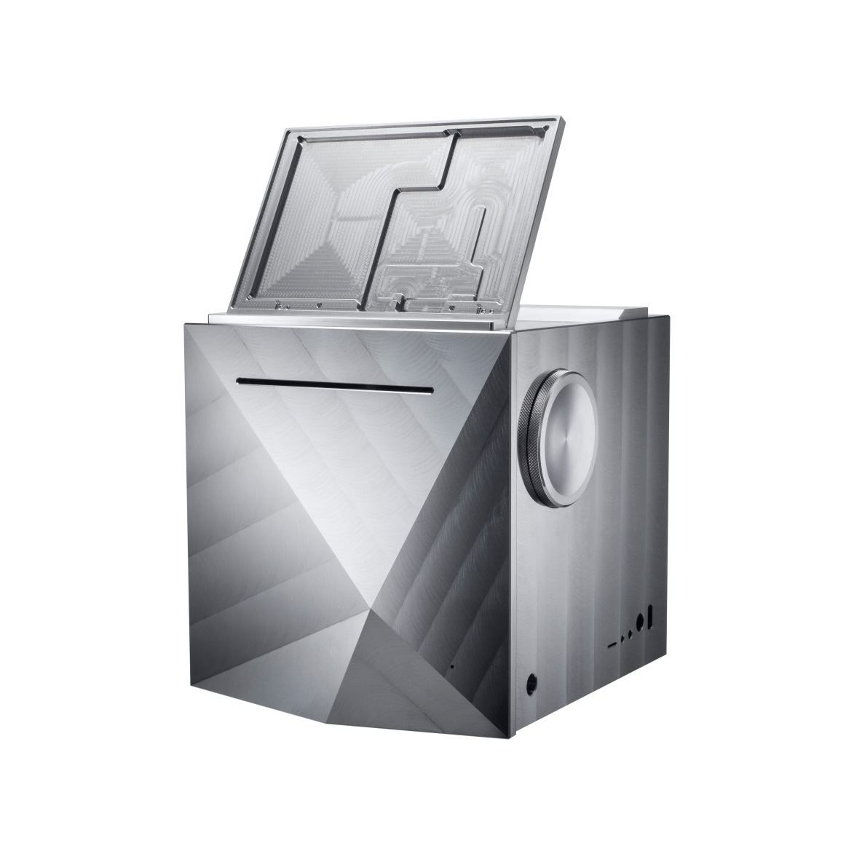
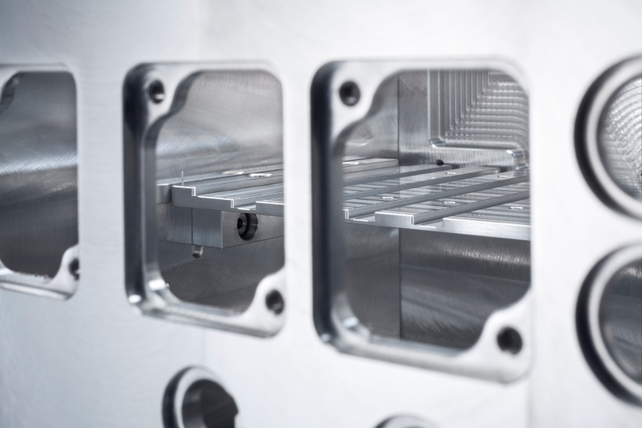
Full Aluminum Body

Slide 8
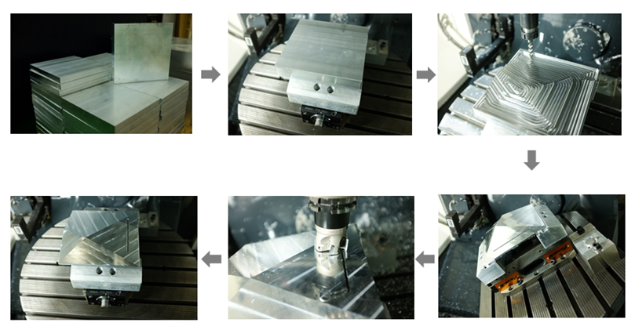
Machining process
A 5-axis machining process is used to create the unique front fascia of the AK500N.

Slide 9
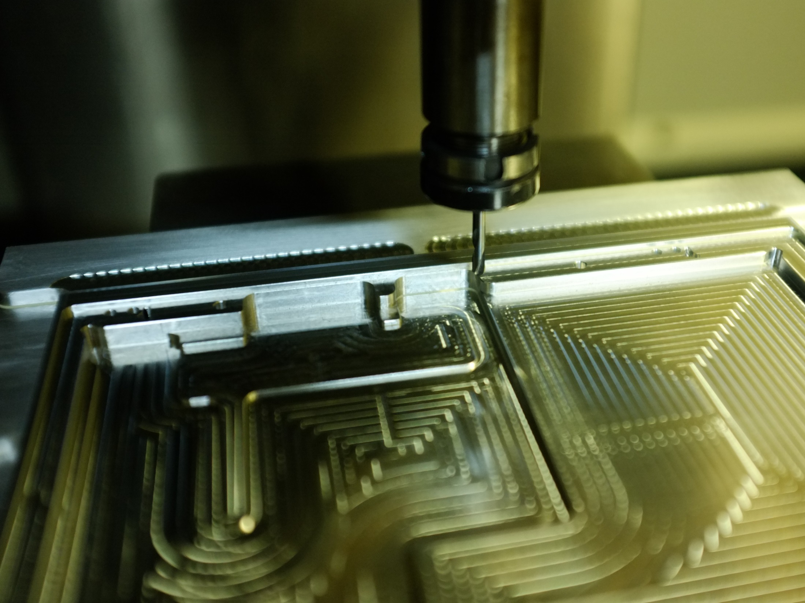
Full aluminum body milled delicately…

Slide 10
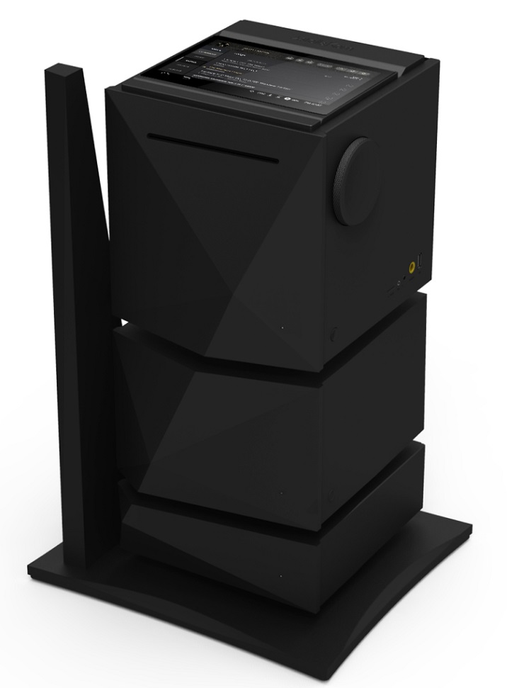
Integrated System
Amplifier and power supplier that can be assembled with AK500N (*Under development)
All in one Audio System with unified design
AK500N Network player
+
AK500A Amplifier
+
AK500P Power Supplier

Slide 11
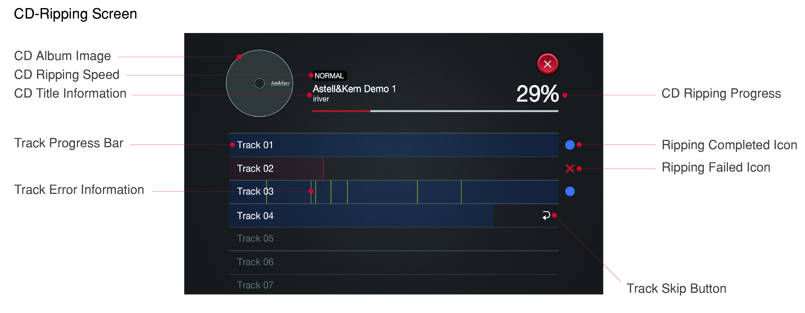
Perfect Extractor
One-Click CD import into AK500N
Highly-optimized ripping engine, cdparanoia
Flawless CD rips through enhanced jitter and error correction support
Tracks can be saved in either WAV or FLAC
Automatic imported Album Art and music data from Gracenote’s latest music DB

Slide 12
Pure Sound
Perfect noise isolation and battery-only operation

Slide 13
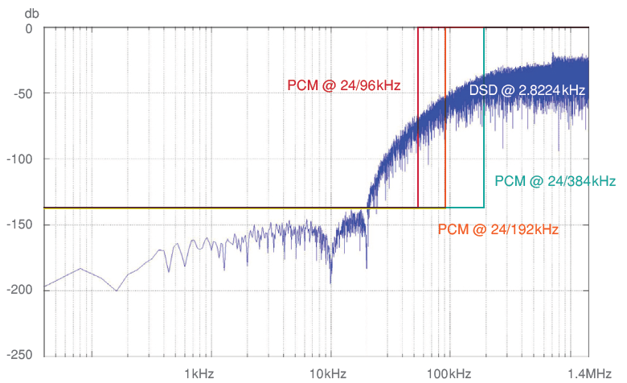
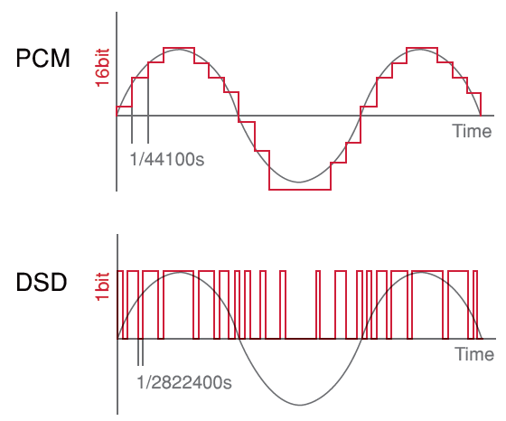
PCM to DSD
Converts 32bit/384kHz and 24bit/352kHz file to DSD64 data without down-sampling.
Real time PCM file to DSD64 data playback
Comparison of noise level PCM and DSD
Comparison of sample rate PCM and DSD

Slide 14
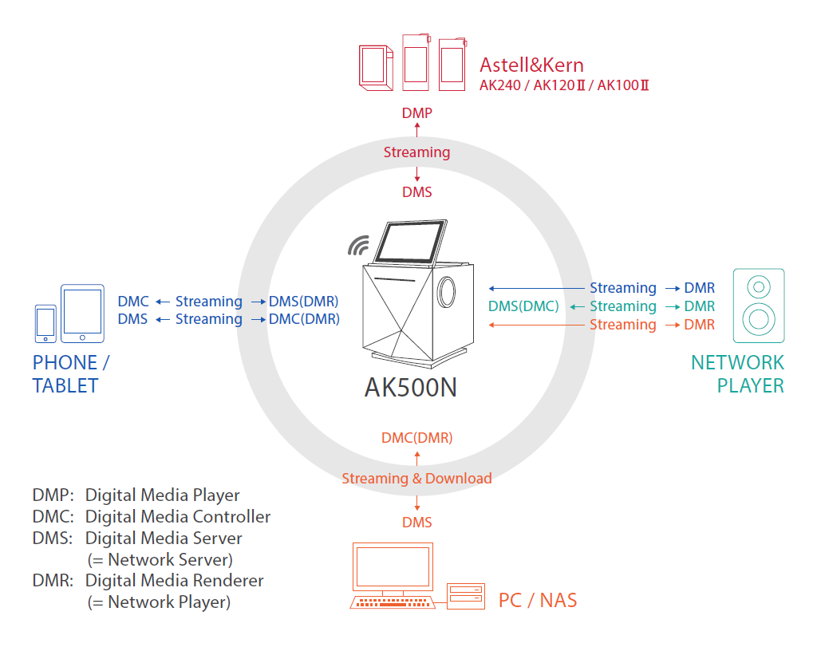
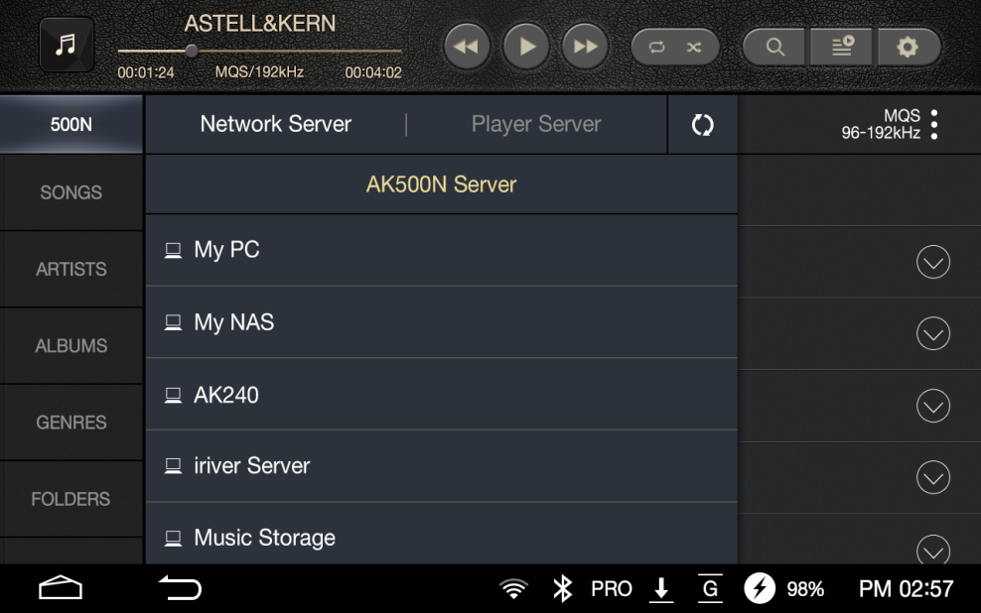
Advanced Network
Connects to PC as well as NAS servers through LAN and Wi-Fi
Controlled by smartphone and tablet with an application
Network Server & Player by DLNA
DLNA Connection

Slide 15
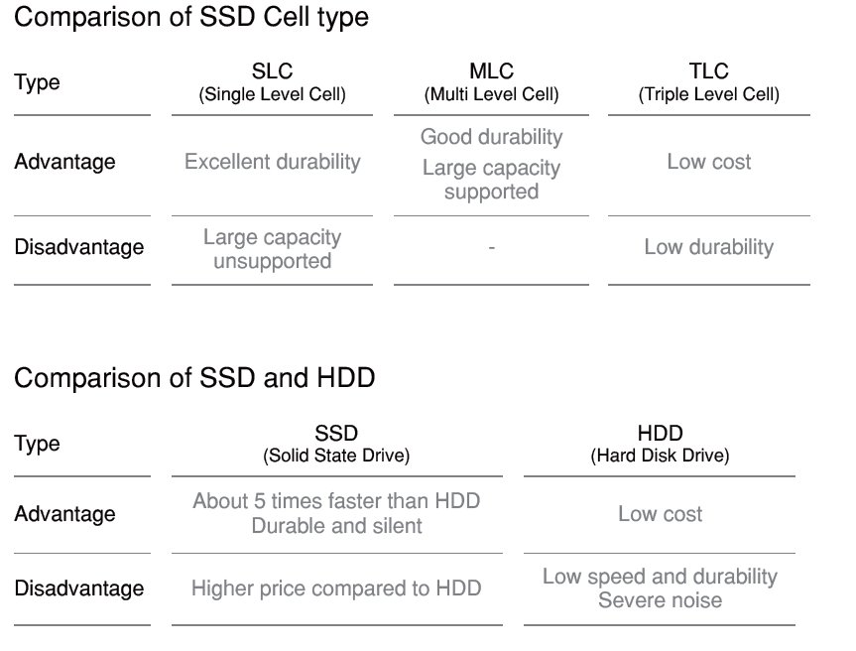
SSD
No vibration noise generated from conventional HDD
SSD, faster and more stable than HDD
Maximum of 4TB Storage
RAID 5 ensures data safety
4 Bay SSD
RAID 5 Structure for 4TB

Slide 16
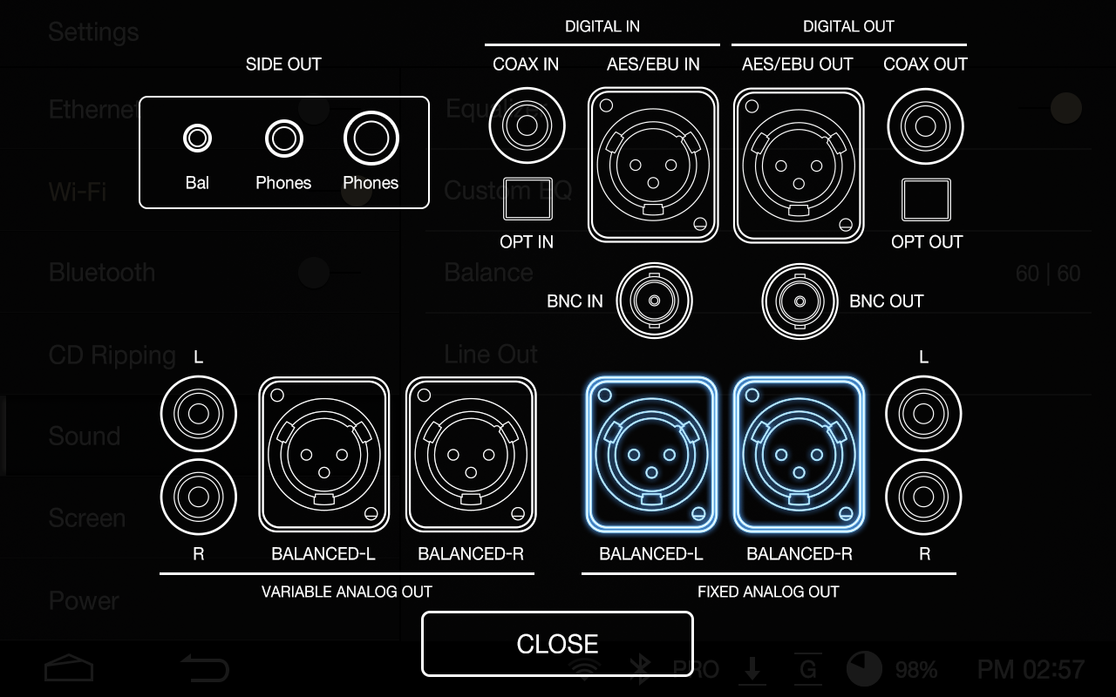
Multiple Input and Output
Supports a wide range of inputs and outputs.
Various digital inputs and outputs(AES/EBU, Coaxial, Optical, BNC)
Analog output supports both Fixed and Variable signals
Easy-to-read graphics on the touch-screen menu
Analog & Digital audio I/O

Slide 17
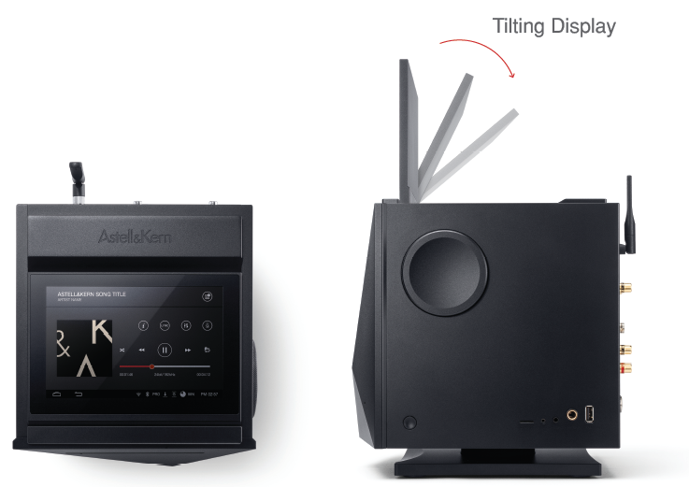
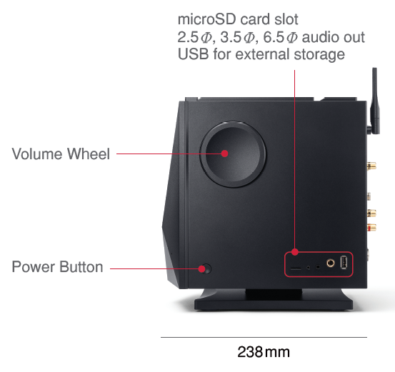
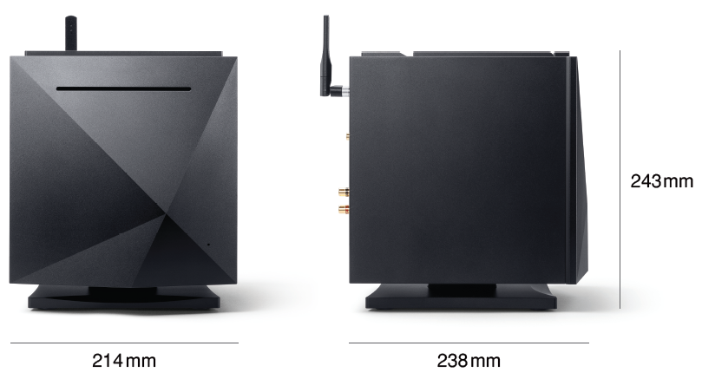
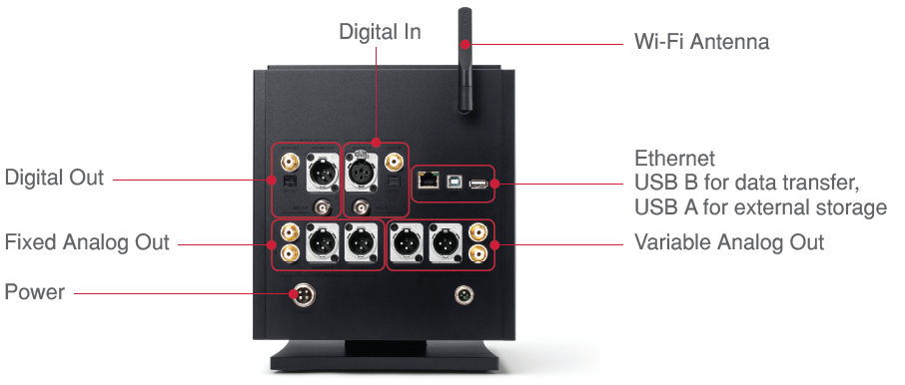
Product View

Slide 18
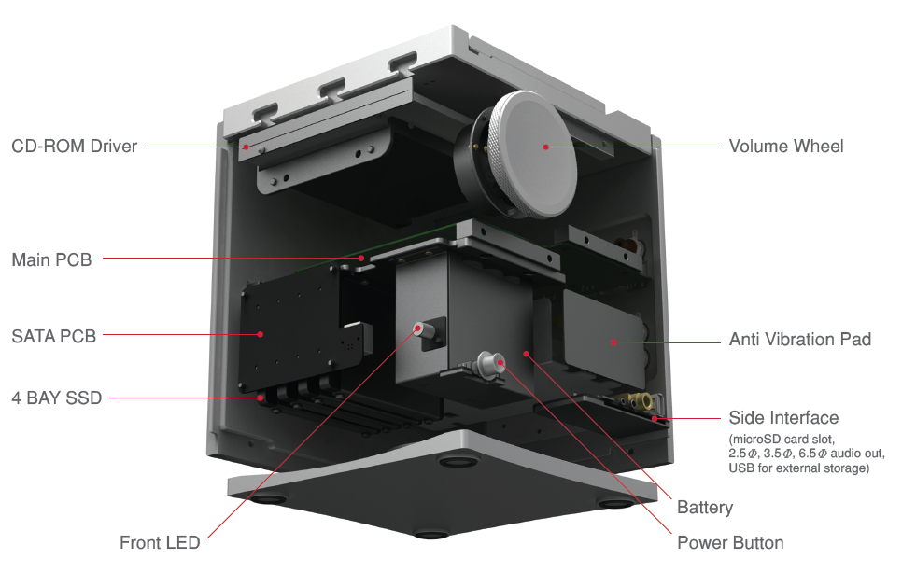
Internal Structure

Slide 19
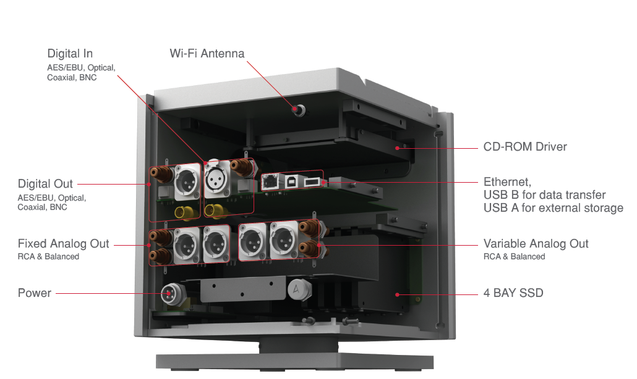
Internal Structure

Slide 20
Specification
Display 7” WXGA(1280 x 800) Touch Display
DAC Cirrus Logic CS4398 x2(Dual DAC)
Storage SSD MLC 1TB/2TB/4TB(RAID 0,5)
Digital Input AES/EBU x1, BNC x1, Coaxial x1, Optical x1
Out AES/EBU x1, BNC x1, Coaxial x1, Optical x1
Analog Out Balanced(L/R) x2, RCA(L/R) x2
Fixed output level 3V(RCA, Balanced)
Variable output level 7.5V(RCA) / 10V(Balanced)
Channel Separation > 135dB / 1kHz
Frequency Response ±0.02dB / 20Hz ~ 20kHz, ±0.4dB / 10Hz ~ 70kHz
THD(Total Harmonic Distortion)+N < 0.0008% / 1kHz / 10V, < 0.001% / 10Hz ~ 20kHz / 10V
SNR(Signal to Noise Ratio) 118dB / 1kHz / 10V
Audio File Supported WAV, FLAC, WMA, MP3, OGG, APE, AAC, ALAC, AIFF, DFF, DSF
Audio Sample Rate 8kHz ~ 384kHz(8/16/24bits per sample)
DSD Native: DSD64(1bit/2.8MHz) / DSD128(1bit/5.6MHz)
USB Supported Type A(Host) x2, Type B(Device) x1
USB DAC Supported UAC(USB Audio Class) 2.0 / DSD64, DSD128, PCM
Network Supported Wi-Fi 802.11b/g/n(2.4GHz) & Ethernet 10/100/1000, DLNA(DMS, DMC, DMR)
CD Ripping audio format WAV, FLAC
Battery Capacity : 10,400mAh / Voltage : 7.4(normally) / Type : Li-Ion
Dimension / Weight 214[W] x 243[H] x 238[D](mm) / 11.4kg

Slide 21
Thank you.

